Slide 1
CO₂ Foam Mobility Control at Reservoir Conditions: High Temperature, High Salinity and Carbonate Reservoirs
Presented by Leyu Cui¹
George Hirasaki¹, Yunshen Chen², Amro Elhag², Ahmed A. Abdala³, Lucas J. Lu^{1,3}, Maura Puerto¹, Kun Ma^{1*}, Ivan Tanakov¹, Ramesh Pudasaini¹, Keith P. Johnston², and Sibani L. Biswal¹
1 Rice University; 2 University of Texas at Austin; 3 the Petroleum Institute at Abu Dhabi; *currently affiliation is TOTAL
Consortium Meeting in Rice, April. 2014
Sponsored by ADNOC and PI

Slide 2
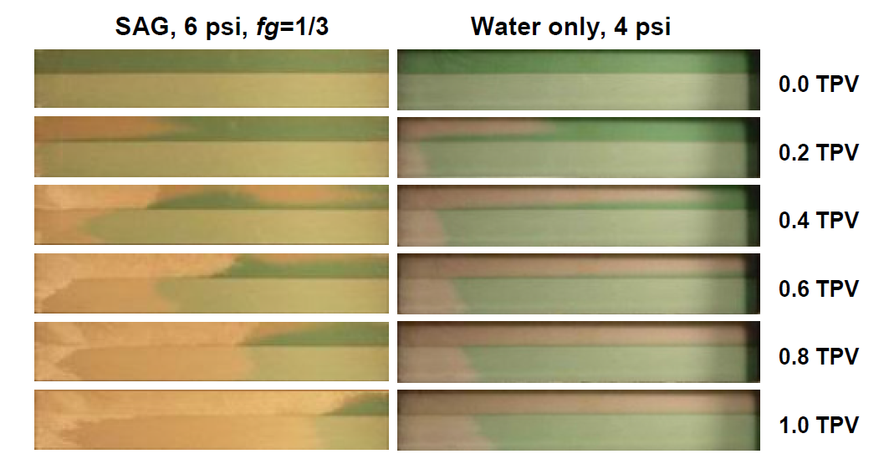
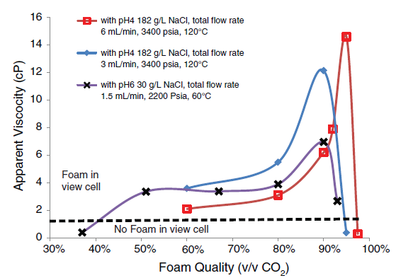
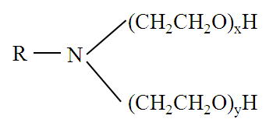
Background and Previous Investigation
Foam Mobility Control in heterogeneous reservoirs:
Improvement of E_{V}
AOS 16-18 and Air Foam
Li, R. F., 2010. SPE-113910-PA.
Ethomeen C12 and CO₂ Foam in Sandpack:
R = Coco group, x+y=2
Chen, Y. et al., 2013. SPE-154222-PA

Slide 3
Evaluation Procedure of Surfactant Formulations for Foam EOR
Can CO₂ foam be generated and applied at reservoir conditions for mobility control?
A systematic procedure should be used to evaluate the foam process:
Evaluation of Surfactant Properties:
Solubility
Thermal Stability
Adsorption
*Partitioning Coefficient for CO₂-soluble surfactant; **Interfacial tension (IFT) for immiscible foam
Investigation of Foam Mobility Control
*Pre-Screening of Foaming Agents in Sandpack
Foam Flooding at Reservoir Conditions
*Chen, Y. et al., 2013. SPE-154222-PA
**Wang, et al., 2001. SPE-72147

Slide 4
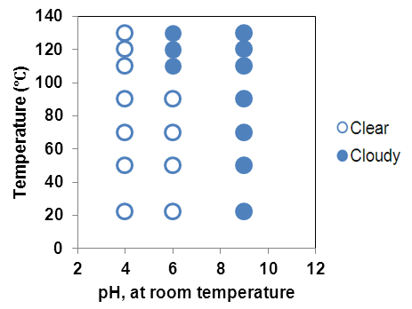
Solubility of Ethomeen C12
CO₂ phase: C12 is CO₂-soluble (SPE-154222-PA)
Aqueous phase: the cloud point of C12 is lower than room temperature at original pH (9.24), and is enhanced with decreasing pH due to the protonation of C12.
1% C12 in brine
(22% TDS):
Na⁺: 71720 ppm
Ca²⁺: 21060 ppm
Mg²⁺: 3063 ppm
Cl⁻: 156777 ppm
Notes:
Note: solubility depends on salinity, pH and temperature. At original pH, C12 in high salinity brine is not water-soluble. At pH=6, the cloud point is higher than 90 C. At pH=4, the cloud point is higher than 130 C.

Slide 5
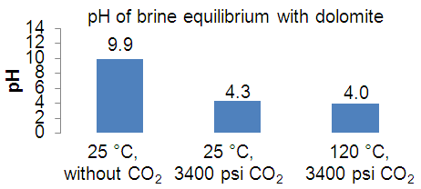
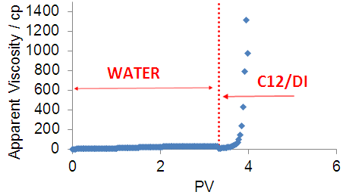
Core Plug by Poor Solubility
The equilibrium pH of dolomite-water without CO₂ is up to 9.9.
C12 is not water-soluble at such high pH.
The core was plugged by C12 during core flooding.
A slug of CO₂ is required to reduce the system pH.
Notes:
Note: the equilibrium pH of brine-dolomite system without CO2 is high, which results in the insolubility of C12 and plug of the core. The equilibrium pH is reduced to around 4 with 3400 psi CO2, which indicates the solubility of C12 can be maintained during CO2 flooding. Thus, a slug of CO2 should be injected to acidify the system, before injecting C12 solution. BTW, the pH was calculated by PHREEQC software. We verified the calculated pH with experiments as discussed later.

Slide 6
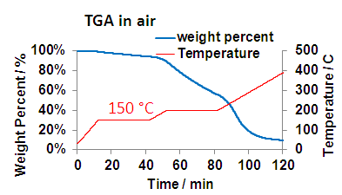
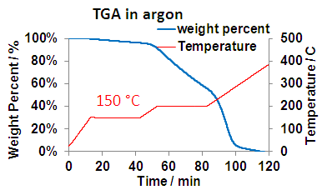
Thermal Stability by DSC and TGA
Differential scanning calorimetry (DSC) and thermal gravimetric analysis (TGA) shows the surfactant is stable at T<150 °C
DSC
150 °C
Lack of water!

Slide 7
Thermal Stability of Ethomeen C12
1% (wt) C12 in HCl solution at pH=4.0 was aged at 125 °C for 11 days. (Note, O₂ was not eliminated)
The HPLC-ELSD analysis results demonstrate the slow degradation.
6.0% C12 was degraded after 11 days, calculated from peak areas.
Oxygen!

Slide 8
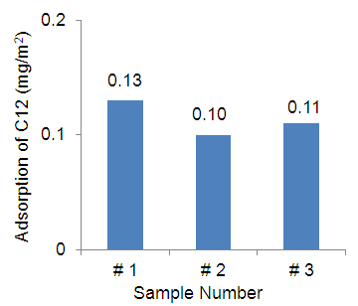
Adsorption of C12 on Potential Formation Minerals
(Cui, et al., 2014, SPE-169040-MS)
Quantitative analysis of XRD revealed that the three core plugs were composed of:
Calcite: 95.4 - 98.6%,
Dolomite: 0.5 - 4.1%,
Quartz: 0.4 - 0.9% .
the adsorption of C12 in synthetic brine is low on the formation material which has low quartz content
BET surface area of the cores samples is 4.00 m²/g.

Slide 9
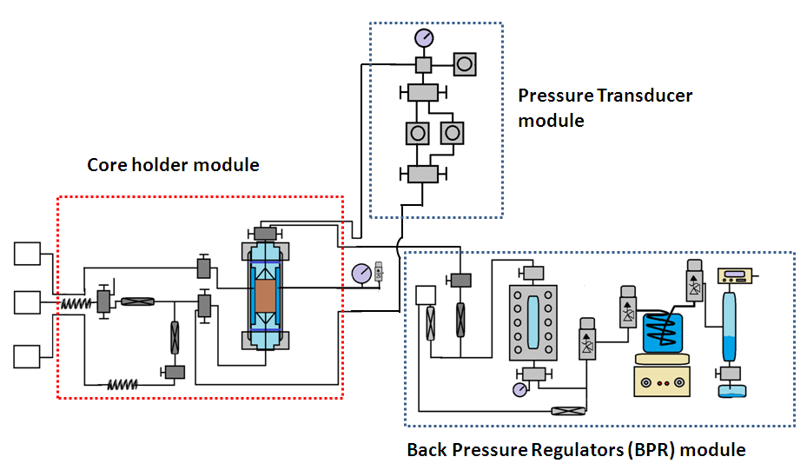
CO₂ Foam Apparatus
Specially designed heating coil, core holder and back pressure regulator system.
Harsh Conditions: 5000 psi, 120 ℃, 22% TDS and low pH (pH ≈ 4)
Hastelloy alloy for wetting materials
Silurian dolomite core:
D=1.5 in., L=3 in. and k= 737 md
Notes:
Note: Core holder and BPR was designed by Maura. The whole setup was designed and built-up by ourselves. The hastelloy parts came from Autoclave, other SS parts came from Swagelok. The o-ring in check valves and relief valves were Kalreze o-ring, which can tolerate CO2

Slide 10
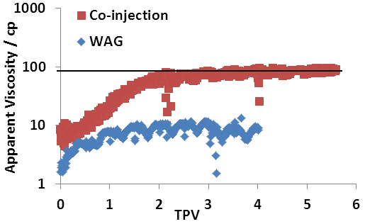
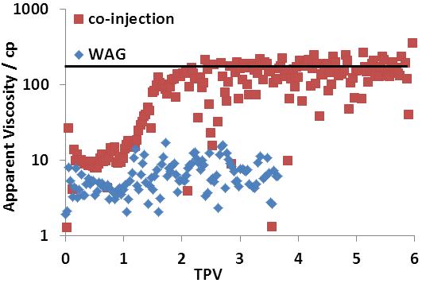
C12/DI and CO₂ Foam at 20 °C
C12/DI and CO₂ were co-injected into a Silurian dolomite core at room temperature, 3400 psi and various foam qualities (gas fraction), following the water alternating CO₂ (WAG).
The foam is strong compared to WAG
30% Foam Quality
70% Foam Quality
µ*=78.91 cp
µ*=139.98 cp
Notes:
Note: C12 is water-soluble at reservoir conditions in CO₂ flooding. To maintain C12’s solubility at injection condition (atmosphere conditions, room temperature, exposed to the air), CO2 was purged on the top of C12 solution to reduce the pH to obtain clear solution. WAG was conducted first to get the reference line and acidify the core system, and then C12/DI and CO₂ were co-injected at 4 ft/day and the same foam quality. The average value at the plateau was taken as the foam apparent viscosity.

Slide 11
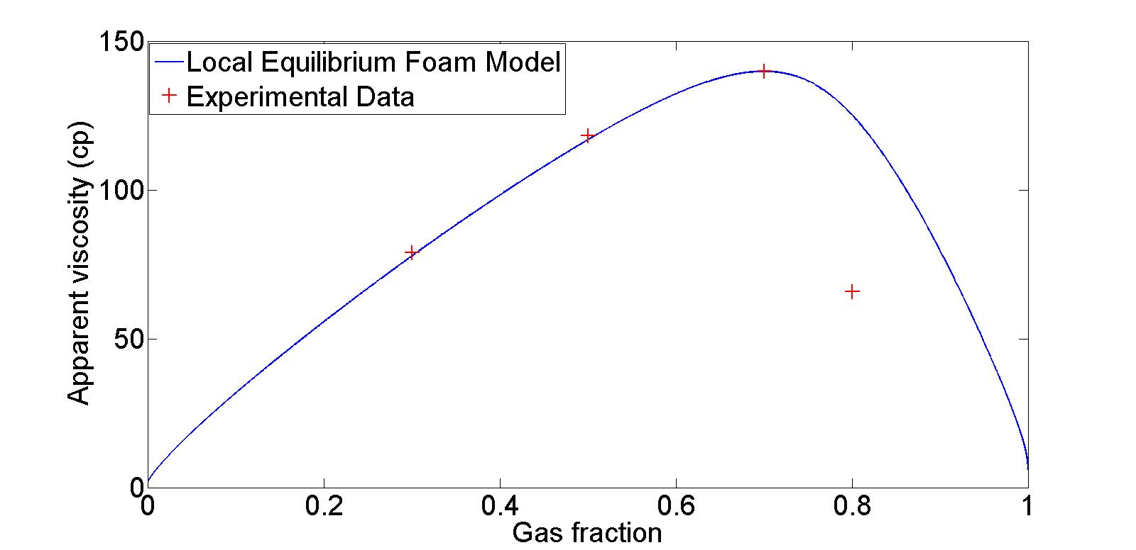
Influence of Foam Quality
*Local equilibrium foam model is the “dry-out” foam model, used in CMG-STARS.
The change of foam strength with foam quality can be divided into:
“Low Quality” regime, transition foam quality, “High Quality” regime.
A slug of water is necessary to maintain the foam apparent viscosity
*Ma, K., Lopez-Salinas, J. L., Puerto, M. C., Miller, C. A., Biswal, S. L., & Hirasaki, G. J. (2013). Energy Fuels, 27(5), 2363–2375.
Notes:
Note: the foam strength increases with foam quality in “low-quality” regime, reaches the maximum at transition foam quality, and decreases with foam quality in “high-quality” regime. In low-quality regime, the foam bubbles can be assumed to be a constant. Thus, the bubble population increases with foam quality, which results in the increase of foam apparent viscosity. But the water saturation decreases with foam growth. As the water saturation approaches a critical water saturation, the limiting capillary pressure is reached, which results in a abrupt coalescence of foam to maintain the water saturation at or above the critical value. Thus, the increase of foam quality results in the more coalescence and destruction of foam in high-quality regime.

Slide 12
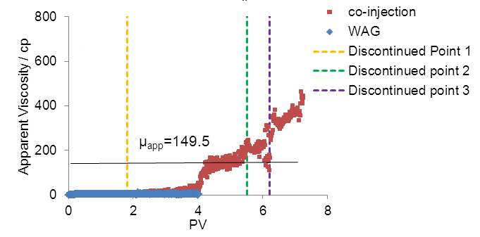
C12/Brine and CO₂ Foam at 20 °C
Brine: Na⁺: 71720 ppm, Ca²⁺: 21060 ppm, Mg²⁺: 3063 ppm, Cl⁻: 156777 ppm and 22.0% TDS
C12/brine and CO₂ can generate strong foam at room temperature.
Salt precipitation was observed at high foam quality, because of the evaporation of water in to the “dry” CO₂.
90% foam quality
CO₂ should be saturated with water before injected
Notes:
Note: Similar to C12/DI water and CO2 foam. Brine alternating CO2 was injected, and then C12/brine and CO₂ were co-injected at 4 ft/day. But salt precipitation was observed at high foam quality. The discontinued point indicates the pumps were stopped for a while. After the 1st discontinued point, the foam apparent viscosity didn’t change. But after the 2nd and 3rd discontinued point, the foam apparent viscosity abruptly increased. That’s because that at the 1st discontinued point, the water saturation in the core is still high because strong foam wasn’t generated. Thus, the evaporation of water to CO2 didn’t result in the salt precipitation. But at the 2nd and 3rd discontinued point, the water saturation is reduced. Thus, the evaporation of water to dry CO2 is significant due to the high CO2 volumetric fraction and results in the precipitation of salt.

Slide 13
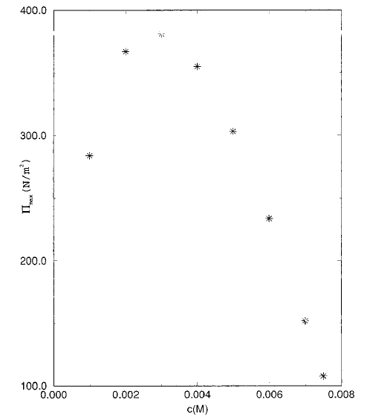
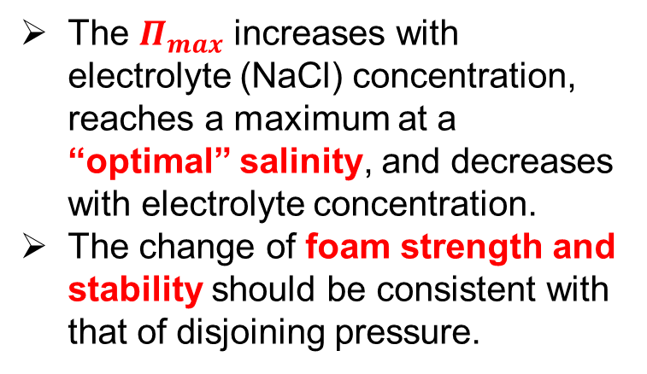
Influence of Salinity
Salinity can stabilize foam by increasing the packing density of surfactants on water-gas interface and destabilize foam by decreasing the electric repulsion of double layers in film plateau.
Disjoining pressure can be utilized to explain the salinity influence.
The $Π_{max}$ increases with electrolyte (NaCl) concentration, reaches a maximum at a “optimal” salinity, and decreases with electrolyte concentration.
The change of foam strength and stability should be consistent with that of disjoining pressure.
(Bhakta and Ruckenstein, 1996)
Notes:
Note: two competitive factors determine the salinity influence on foam strength. The electric repulsion between surfactant molecules can be reduced by electrolyte, which results in the increase of the packing density of surfactants on the water-gas interface and stabilize the foam. Simultaneously, the electric repulsion of double layers in film plateau is reduced by electrolyte, which results in the decrease of disjoining pressure to destabilize foam.
The maximum disjoining pressure increases with electrolyte (NaCl) concentration, reaches a maximum at a “optimal” salinity, and decreases with electrolyte concentration. The “optimal” salinity here is not the same as the optimal salinity in phase behavior measurements. The foam strength and stability should have the same trend as disjoining pressure does.

Slide 14
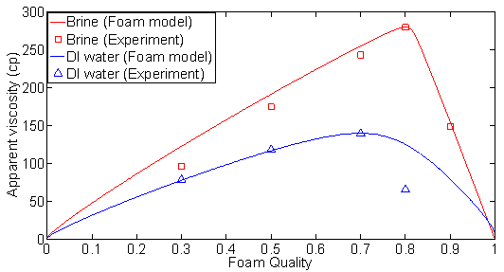
Salinity: Stabilization
Salinity in synthetic brine is favorable for C12 and CO₂ foam strength.
Salinity in synthetic brine is around the “optimal” salinity
Notes:
Note: Salinity in brine is favorable for C12 and CO2 foam, which indicates the salinity in brine is around the “optimal” salinity for maximum disjoining pressure. So, the foam is more stable in brine.

Slide 15
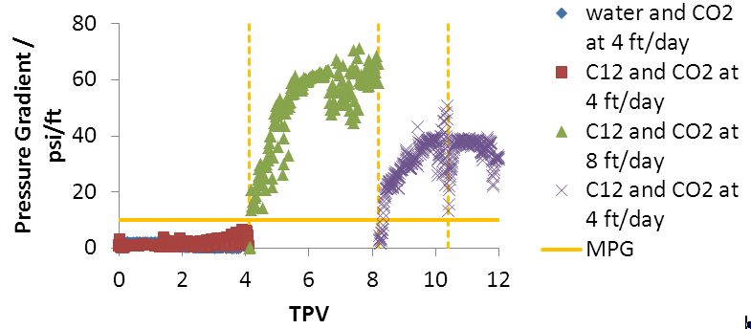
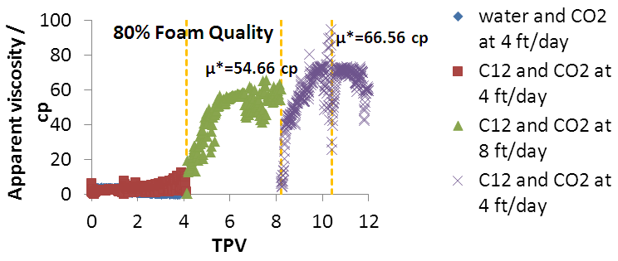
C12/Brine and CO₂ foam at 120 ℃
C12/brine and CO₂ can generate strong foam at high temperature
Minimum Pressure Gradient (MPG) exists. High flow rate is required to reach the MPG to onset the foam generation at high foam quality.
Notes:
Note: C12/brine and CO2 can generate foam at elevated T. Minimum pressure gradient (10psi/ft) was observed. The co-injection starts at 4 ft/day. The pressure gradient is lower than 10 psi/ft, no strong foam was generated. Inject fluids at 8 ft/day, the foam was readily generated due to the high pressure gradient. The foam kept generating after the flow rate was switched back to 4 ft/day. Although the pressure gradient is higher at 8 ft/day, but the foam apparent viscosity is low due to the shear-thinning effect. The shear-thinning effect allows the high injectivity near the well bore zone, and stronger foam existing in the deep reservoir.

Slide 16
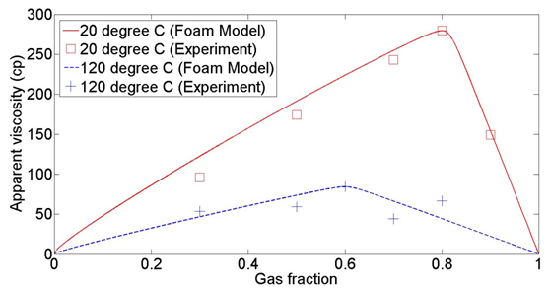
Influence of Elevated Temperature
Dehydration of EO and OH head groups at elevated temperature reduces the size of surfactant molecules, increases the packing density and stabilizes the foam.
The enhancement of thermal motion of surfactant molecules decreases the packing density and destabilize the foam.
Elevated reservoir temperature (120 ℃) is detrimental for C12/brine and CO₂ foam strength due to the short length of EO group.
Notes:
Note: the elevated temperature affects the foam strength by two competitive factors. The detrimental factor dominates the influence for C12/brine and CO2 foam at 120 ℃. Notice that the foam apparent viscosity is a weaker function of foam quality at elevated temperature compared to that at room temperature. This indicates the foam apparent viscosity was relatively steady at elevated temperature in SAG process.

Slide 17
Conclusions – Evaluation Results
The solubility of C12 depends on pH and temperature. C12 is water-soluble at 120 °C in CO₂ flooding processes.
C12 is slowly degraded at 125 °C and pH=4. But oxygen was not eliminated and may cause this degradation.
The adsorption of C12 is low on relative pure carbonate surface.
Ethomeen C12 and CO₂ can generate strong foam at reservoir conditions, i.e., high temperature, high salinity and carbonate minerals.

Slide 18
Conclusions – Field Application
Ethomeen C12 is suggested to be injected in CO₂ phase to maintain the solubility at reservoir conditions, because of the low pH of aqueous phase in the presence of CO₂.
A slug of water should be injected to maintain the CO₂ foam strength, although Ethomeen C12 is a CO₂-soluble surfactant.
The CO₂ phase should be saturated with water before injected to prevent the salt precipitation.
The high minimum pressure gradient (10 psi/ft) for foam generation at reservoir conditions may reduce of the injectivity and result in the failure of foam generation in situ.
Sufficient divalent cations are needed to suppress the dissolution of carbonate mineral in CO₂ and water flooding.

Slide 19
Acknowledgement and Questions?
Thank you.
We acknowledge financial support from the Abu Dhabi National Oil Company (ADNOC), and the Petroleum Institute (PI), U.A.E and partial support from the US Department of Energy (under Award No. DE-FE0005902)

Slide 20
Backup

Slide 21
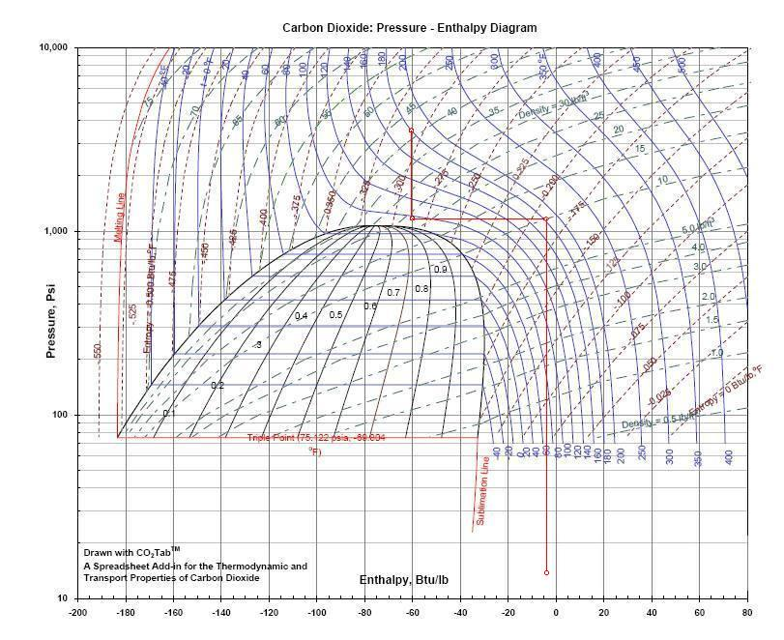
Carbon Dioxide: Pressure-Enthalpy Diagram
3400 psi, 82 ˚C (180 ˚F)
Joule-Thomson Expansion
Isobaric Heating
1200 psi, 35 ˚C
1200 psi, 82 ˚C
Joule-Thomson Expansion
14 .5psi, 15 ˚C
*Good plant design and operation for onshore carbon capture installations and onshore pipelines, Energy Institute, 2010 09,

Slide 22
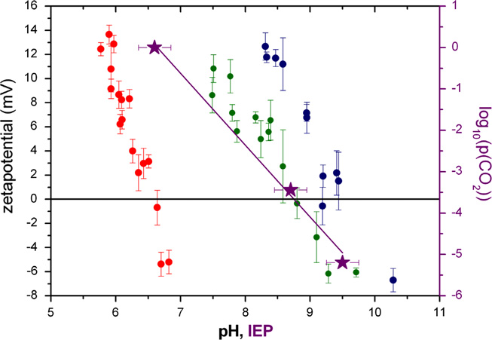



Zeta Potential of Carbonate Minerals with CO₂
The surface charge can’t be directly measured, so zeta potential is generally used.
The sign of zeta potential is determined by surface charge.
The zeta potential changes with partial pressure of CO₂.
Purple asterisks and line display the linear relation between IEP and log₁₀(pCO₂))
(Heberling, et al., 2011)

Slide 23
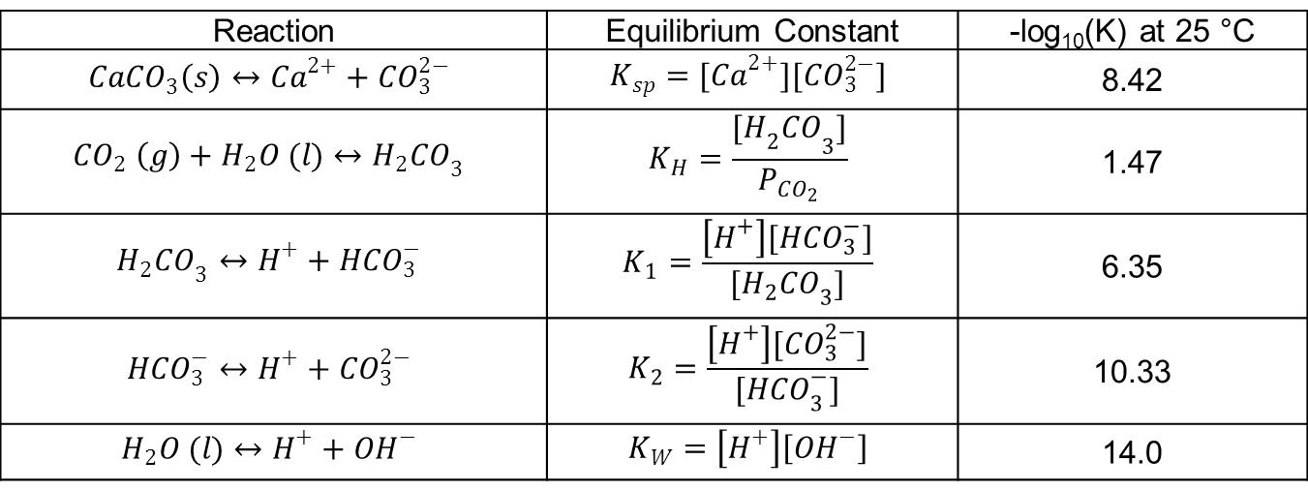
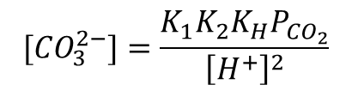
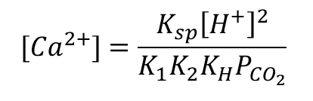
Calcite-H₂O-CO₂ System
9 species were constrained by 5 reactions in 3 phases.
Reaction | Equilibrium Constant | -log₁₀(K) at 25 °C
$${CaCO}_{3}\left(s\right)↔{Ca}^{2+}+{CO}_{3}^{2−}$$ | $$K_{sp}={[Ca}^{2+}][{CO}_{3}^{2−}]$$ | 8.42
$${CO}_{2} \left(g\right)+H_{2}O (l)↔{H_{2}CO}_{3}$$ | $$K_{H}=\frac{{{[H}_{2}CO}_{3}]}{P_{CO_{2}}}$$ | 1.47
$${H_{2}CO}_{3}↔H^{+}+{HCO}_{3}^{−}$$ | $$K_{1}=\frac{\left[H^{+}\right][{HCO}_{3}^{−}]}{{[H_{2}CO}_{3}]}$$ | 6.35
$${HCO}_{3}^{−}↔H^{+}+{CO}_{3}^{2−}$$ | $$K_{2}=\frac{\left[H^{+}\right][{CO}_{3}^{2−}]}{{[HCO}_{3}^{−}]}$$ | 10.33
$$H_{2}O (l)↔H^{+}+{OH}^{−}$$ | $$K_{W}=\left[H^{+}\right]\left[{OH}^{−}\right]$$ | 14.0
The total freedom degree of the system is 3, i.e., T, pH and P_{CO2}.
The potential determining ions (PDI) at 25 °C:
$${[Ca}^{2+}]=\frac{K_{sp}{\left[H^{+}\right]}^{2}}{K_{1}K_{2}K_{H}P_{CO_{2}}}$$
$${[CO}_{3}^{2−}]=\frac{K_{1}K_{2}K_{H}P_{CO_{2}}}{{\left[H^{+}\right]}^{2}}$$

Slide 24
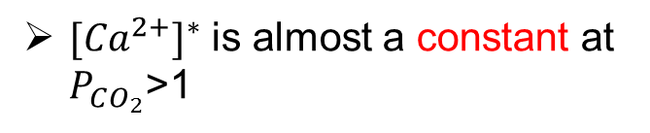

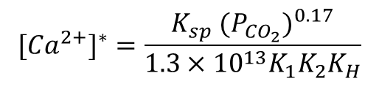

Isoelectric Calcium Concentration ${[Ca}^{2+}]^{∗}$
At a fixed T and zero zeta potential, the freedom degree is 1.
the isoelectric pH* is determined by the partial pressure of CO₂ as well.
log($P_{CO_{2}}$)= -1.71 pH*+11.2
The isoelectric calcium concentration is used to determine the zeta potential:
$${[Ca}^{2+}]^{∗}=\frac{K_{sp} ({P_{CO_{2}})}^{0.17}}{1.3×{10}^{13}K_{1}K_{2}K_{H}}$$
${[Ca}^{2+}]^{∗}$ is almost a constant at $P_{CO_{2}}$>1

Slide 25
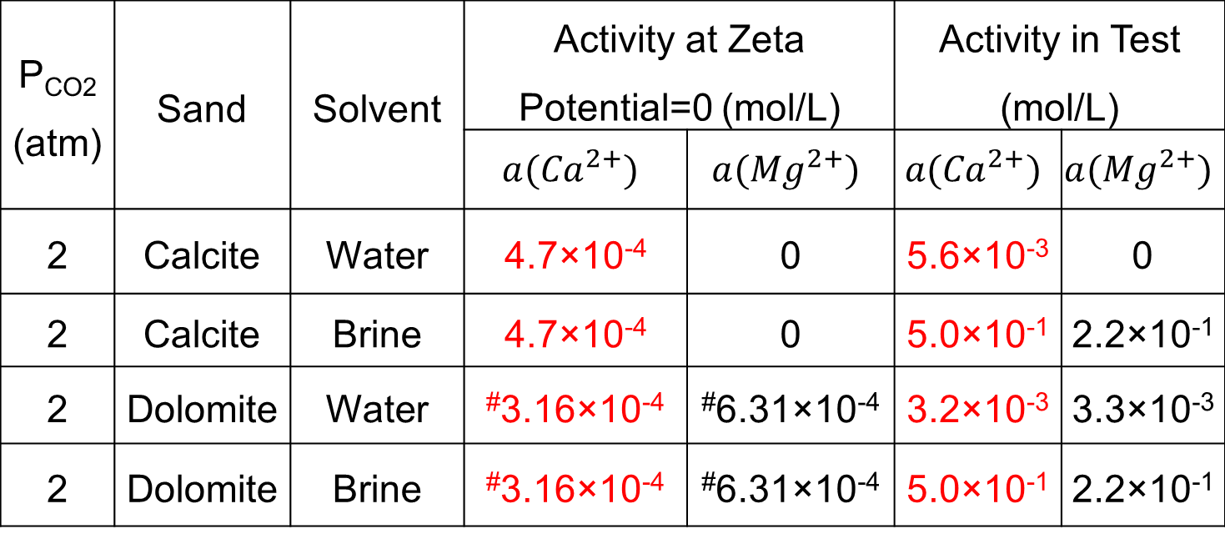
Positive Surface Charge of Carbonate Minerals
The zeta potential of carbonate minerals is predicted to be positive in adsorptions test at 25 °C and 2 atm CO₂
P_{CO2} (atm) | Sand | Solvent | Activity at Zeta Potential=0 (mol/L) |  | Activity in Test (mol/L)
 |  |  | $${a(Ca}^{2+})$$ | $${a(Mg}^{2+})$$ | $${a(Ca}^{2+})$$ | $${a(Mg}^{2+})$$
2 | Calcite | Water | 4.7×10⁻⁴ | 0 | 5.6×10⁻³ | 0
2 | Calcite | Brine | 4.7×10⁻⁴ | 0 | 5.0×10⁻¹ | 2.2×10⁻¹
2 | Dolomite | Water | #3.16×10⁻⁴ | #6.31×10⁻⁴ | 3.2×10⁻³ | 3.3×10⁻³
2 | Dolomite | Brine | #3.16×10⁻⁴ | #6.31×10⁻⁴ | 5.0×10⁻¹ | 2.2×10⁻¹
(#: the experimental data cited from Pokrovsky, et al. (1999) )

Slide 26
Adsorption of C12 on Pure and Natural Carbonate
The low adsorption of C12 on calcite is expected, because of the positive surface charge.
The adsorption on natural carbonate mineral, i.e., natural dolomite, is high.
The high adsorption on the natural dolomite was probably caused by negatively charged impurities on the surface.

Slide 27
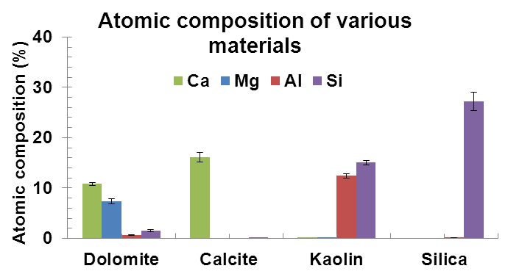
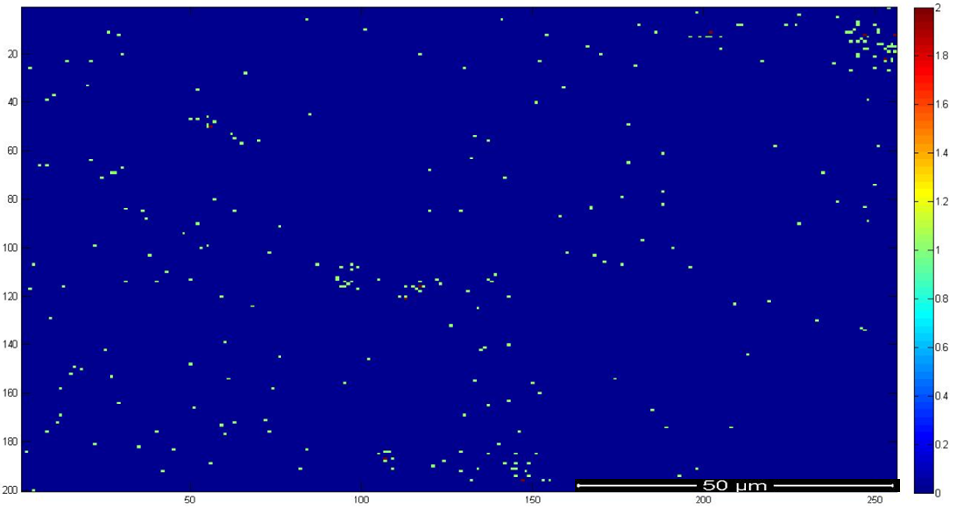
Surface Chemistry
X-ray Photoelectron Spectroscopy (XPS) indicates the existence of impurities in natural dolomite.
Energy Dispersive Spectroscopy (EDAX) demonstrated the silica atom distributes over the whole surface.
(Ma, et al., 2013)
The blue color is the carbonate surface background; other colored spots are the silica and/or silicate impurity. The strength of silica response increases from blue to red color.
SPE-169040-MS, Adsorption of a Switchable Cationic Surfactant on Natural Carbonate Minerals, Leyu Cui

Slide 28
Adsorption of C12 on Silica
Na⁺ doesn’t affect the adsorption.
Multivalent cations, i.e., Mg²⁺, Ca²⁺ and Al³⁺, can reduce the adsorption.
The effectiveness for adsorption reduction depends on the cations type.
 | DI | NaCl | MgCl₂ | Brine | Brine+AlCl₃
Al³⁺ (mol/L) | 0 | 0 | 0 | 0 | 1.51×10⁻³
Ca²⁺ (mol/L) | 0 | 0 | 0 | 5.25×10⁻¹ | 5.25×10⁻¹
Mg²⁺(mol/L) | 0 | 0 | 1.69 | 1.26×10⁻¹ | 1.26×10⁻¹
Na⁺ (mol/L) | 0 | 5.08 | 0 | 3.12 | 3.12

Slide 29
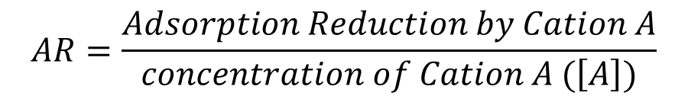
Adsorption Reduction per Unit Cations Concentration
$$AR=\frac{Adsorption Reduction by Cation A}{concentration of Cation A (\left[A\right])}$$
The effectiveness of the cations for adsorption reduction ranges in the order of Al³⁺>Ca²⁺>Mg²⁺.
However, the Al³⁺ concentration in water is low, because of the low solubility product of Al(OH)₃.
Other trivalent cations with high solubility should be used.

Slide 30
Adsorption of C12 on Silica
Na⁺ doesn’t affect the adsorption.
Multivalent cations, i.e., Mg²⁺, Ca²⁺ and Al³⁺, can reduce the adsorption.
The effectiveness for adsorption reduction depends on the cations type.
 | DI | NaCl | MgCl₂ | Brine | Brine+AlCl₃
Al³⁺ (mol/L) | 0 | 0 | 0 | 0 | 1.51×10⁻³
Ca²⁺ (mol/L) | 0 | 0 | 0 | 5.25×10⁻¹ | 5.25×10⁻¹
Mg²⁺(mol/L) | 0 | 0 | 1.69 | 1.26×10⁻¹ | 1.26×10⁻¹
Na⁺ (mol/L) | 0 | 5.08 | 0 | 3.12 | 3.12

Slide 31
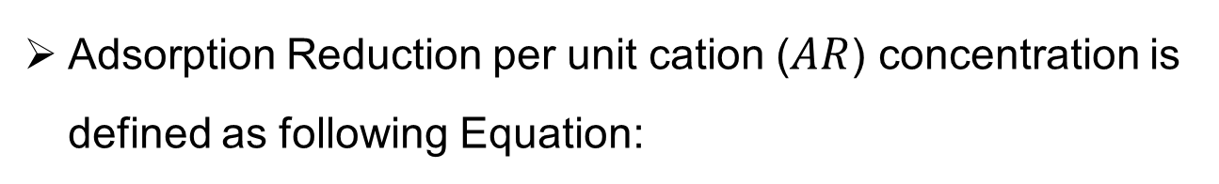
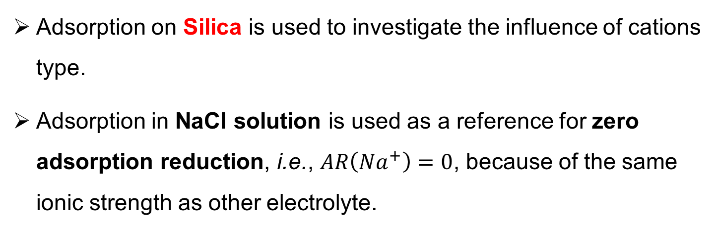
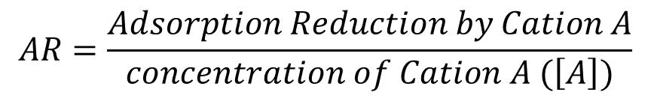
Adsorption Reduction per Unit Cations Concentration-1
Adsorption Reduction per unit cation ($AR$) concentration is defined as following Equation:
$$AR=\frac{Adsorption Reduction by Cation A}{concentration of Cation A (\left[A\right])}$$
Adsorption on Silica is used to investigate the influence of cations type.
Adsorption in NaCl solution is used as a reference for zero adsorption reduction, i.e., $AR\left({Na}^{+}\right)=0$, because of the same ionic strength as other electrolyte.

Slide 32
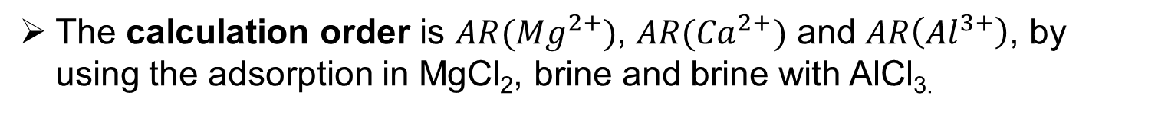
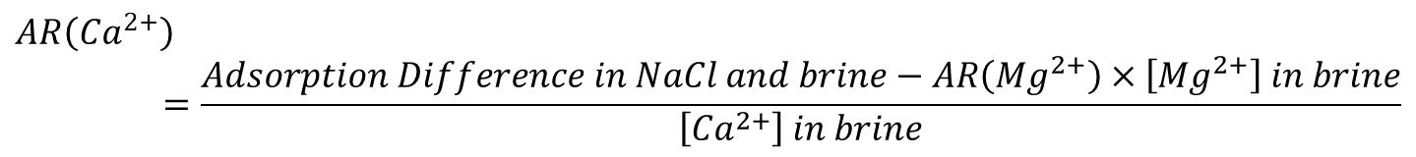
Adsorption Reduction per Unit Cations Concentration-2
The calculation order is $AR({Mg}^{2+})$, $AR({Ca}^{2+})$ and $AR\left({Al}^{3+}\right)$, by using the adsorption in MgCl₂, brine and brine with AlCl_{3.}
$$AR\left({Mg}^{2+}\right)=\frac{Adsorption Difference in NaCl and MgCl_{2}}{\left[{Mg}^{2+}\right] in MgCl_{2} solution}$$
$$AR\left({Ca}^{2+}\right)=\frac{Adsorption Difference in NaCl and brine−AR\left({Mg}^{2+}\right)×\left[{Mg}^{2+}\right] in brine}{\left[{Ca}^{2+}\right] in brine}$$
$$AR\left({Al}^{3+}\right)=\frac{Adsorption Difference in brine with and without{Al}^{3+}}{\left[{Al}^{3+}\right] in brine}$$

Slide 33
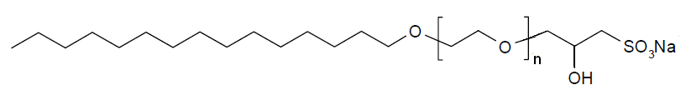
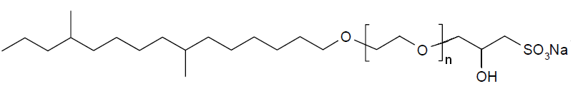
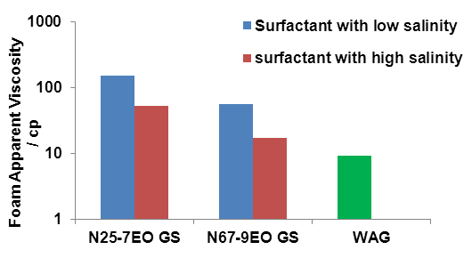
Salinity: Destabilization
N25-7EO GS: Alkyl (C 12-15, 80% linear and 20% branches) Glycidyl Ether Sulfonates with 7 EO.
N67-9EO GS: Alkyl (C 16-17, methyl branches) Glycidyl Ether Sulfonates with 9 EO.
N₂ foam in sandpack
low salinity brine: 3.5% (wt) NaCl
1.0% (wt) Na₂CO₃
high salinity brine: 127.00 g/L NaCl, 53.29 g/L CaCl₂·2H₂O, 22.67 g/L MgCl₂∙6H₂O 0.69 g/L Na₂SO₄.
Notes:
Note: the salinity in high salinity brine was detrimental to the foam strength. That may be because the salinity has far exceeded the “optimal” salinity.

Slide 34
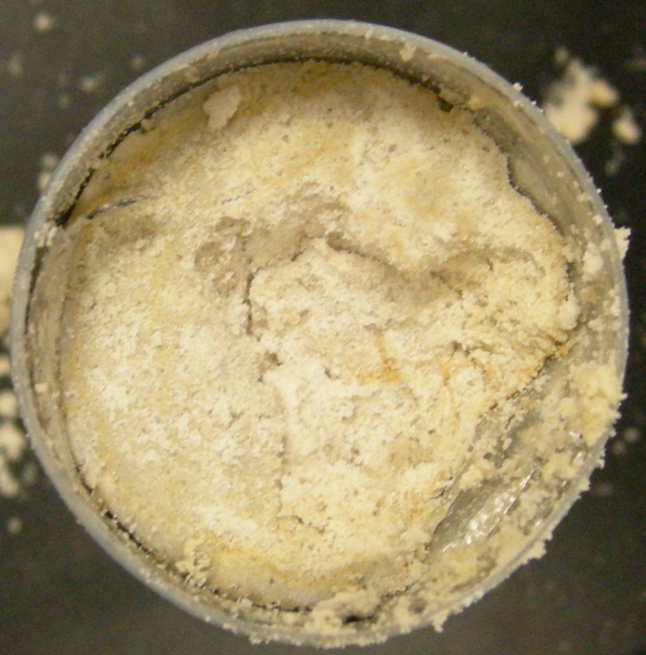
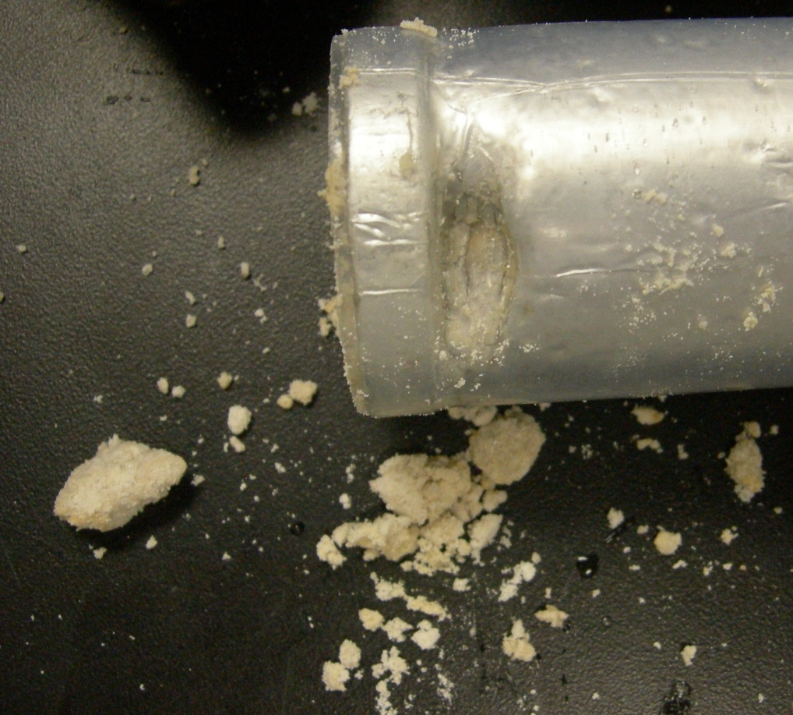
Mineral Dissolution
The carbonate mineral was dissolved in DI water and CO₂.
The sufficient divalent cations, i.e., Ca²⁺ and Mg²⁺, are suggested to be added in brine.
Notes:
Note: Obvious mineral dissolution was observed in CO2 and water flooding. Thus, sufficient divalent cations should be added in brine to prevent the formation damage.

Slide 35
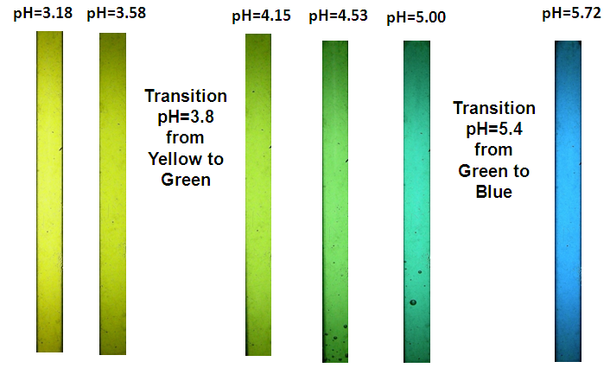
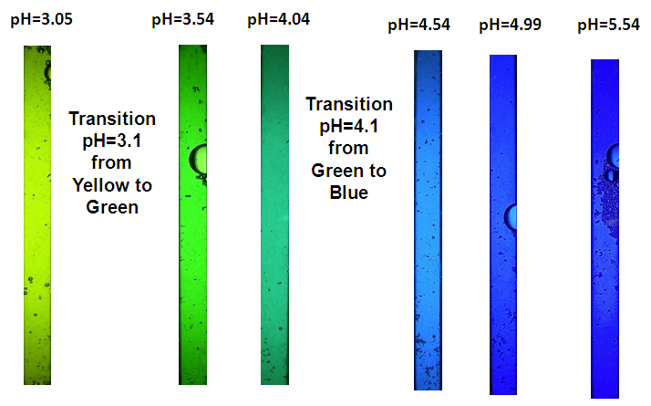
Color Code of Bromocresol Green (BCG)
Bromocresol Green (BCG): pH<3.8 yellow, pH=3.8-5.4 green, pH>5.4 blue in the absence of surfactant
Bromocresol Green (BCG): pH<3.1 yellow, pH=3.1-4.1 green, pH>4.1 blue in the presence of C12.
H⁺ ions were repelled from C12 micelle surface. pH in bulk phase is lower than on micelle surface.
Notes:
Note: The transition pH of BCG is shifted down in the presence of C12. Because C12 micelle carries positive charge, which repels the H+ ions. pH in bulk phase is lower than on micelle surface. And the pH measured by electrode is bulk phase pH, pH demonstrated by BCG is micelle pH, which results in the apparent pH is shifted down in the presence of C12. The fine bubbles filled most of the tube in foam flooding at 3 and 4 PV, but the color is still green. That indicates the pH was between 3.1-4.1 and C12 is water-soluble in CO2 foam flooding.

Slide 36
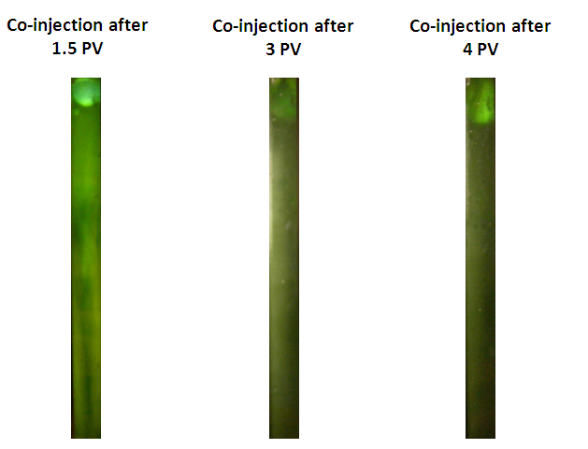
pH in Foam Flooding
Bromocresol Green (BCG): pH<3.1 yellow, pH=3.1-4.1 green, pH>4.1 blue in the presence of C12.
The measured pH in foam flooding was 3.1-4.1, which is consistent with calculated equilibrium pH=4.0
Ethomeen C12 is water-soluble during CO₂ foam flooding.
Notes:
Note: The transition pH of BCG is shifted down in the presence of C12. Because C12 micelle carries positive charge, which repels the H+ ions. pH in bulk phase is lower than on micelle surface. And the pH measured by electrode is bulk phase pH, pH demonstrated by BCG is micelle pH, which results in the apparent pH is shifted down in the presence of C12. The fine bubbles filled most of the tube in foam flooding at 3 and 4 PV, but the color is still green. That indicates the pH was between 3.1-4.1 and C12 is water-soluble in CO2 foam flooding.

Slide 37
C12/DI and CO₂ Foam Pressure History at 20 °C and 3400 psi
30% Foam Quality
50% Foam Quality
µ*=78.91 cp
µ*=118.30 cp
70% Foam Quality
80% Foam Quality
µ*=65.72 cp
µ*=139.98 cp

